Slide 1
SPIRiT:
Iterative Self-consistent Parallel Imaging Reconstruction from Arbitrary k-Space

Slide 2
SPIRiT : Iterative Self-consistent Parallel Imaging Reconstruction from Arbitrary k-Space
Generalized reconstruction framework based on self-consistency
Reconstruction is able to be formulated as an optimization that yields the most consistent solution with calibration and acquisition data
The formulation can flexibly incorporate additional image priors (off-resonance correction, regularization terms)
Several iterative strategies to solve the posed reconstruction are presented (POCS, CG)

Slide 3
1. Cartesian GRAPPA (Recap)
1.1 GRAPPA
1.2 Tikhonov regularized least-square solution
2. Method
2.1 Consistency With the Calibration
2.2 Consistency With the Data Acquisition
2.3 Constrained Optimization Formulation
2.4. Arbitrary Cartesian Sampling
2.4.1 Projection Over Convex Sets(POCS) algorithm
2.5. Non-Cartesian Sampling
2.5.1 Calibration
2.5.2 k-Space Domain Reconstruction
2.5.3 Revisiting the Calibration
3. Reconstruction
3.1 k-Space based Reconstruction
3.2 Image-space based Reconstruction
3.3 Off-resonance Correction
3.4 Regularization

Slide 4
1.
Cartesian
GRAPPA
The GRAPPA reconstruction posed the parallel imaging reconstruction as a translation variant interpolation problem in k-space
“Translation Invariant” might be right
(LTI, convolution kernel is able to be applied to all k-space without any restriction on position)
Unlike SENSE, GRAPPA attempts to
reconstruct the individual coil images directly.

Slide 5


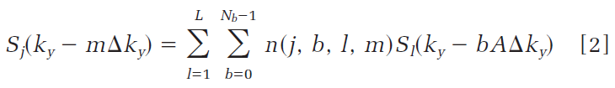
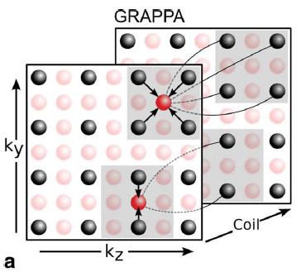
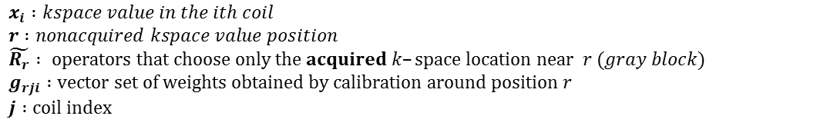


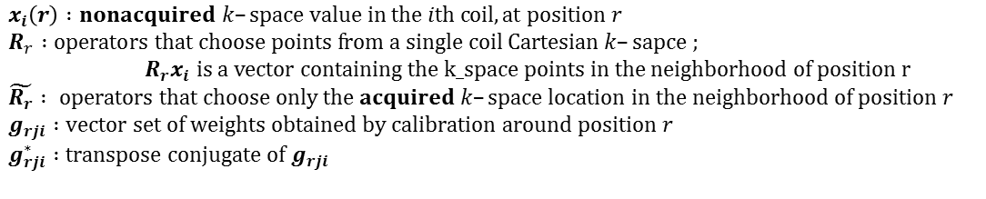





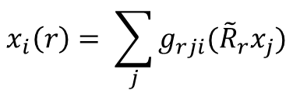

1.1 GRAPPA
Recovery of point $x_{i}\left(r\right)$is synthesized by a linear combination of acquired neighboring k-space data from all coils
$x_{i}\left(r\right) :nonacquired k–space value in the ith coil, at position r$
$R_{r} :operators that choose points from a single coil Cartesian k–sapce ;$
$R_{r}x_{i} is a vector containing the k_space points in the neighborhood of position r$
$\tilde{R_{r}} : operators that choose only the acquired k–space location in the neighborhood of position r$
$g_{rji} :vector set of weights obtained by calibration around position r$
$g_{rji}^{∗} :transpose conjugate of g_{rji}$
g*Rx // convolution notation (g(x)Rx)
g or Rx should be flipped to convolve
$$a_{2}$$
$$b_{2}$$
$$a_{1}$$
$$b_{1}$$
$$c_{2}$$
$$d_{2}$$
$$x_{1}(r)$$
$x_{i} :kspace value in the ith coil$
$r :nonacquired kspace value position$
$\tilde{R_{r}} : operators that choose only the acquired k–space location near r (gray block)$
$g_{rji} :vector set of weights obtained by calibration around position r$
$j :coil index$
$$c_{1}$$
$$d_{1}$$
$$x_{i}\left(r\right)= \sum_{j}{g_{rji}({\tilde{R}}_{r}x_{j})}$$
$$x_{i=1}\left(r\right)= g_{r,j=1,i=1}\left[\begin{matrix}a_{1} & b_{1} \\ c_{1} & d_{1}\end{matrix}\right]+g_{r,j=2,i=1}\left[\begin{matrix}a_{2} & b_{2} \\ c_{2} & d_{2}\end{matrix}\right]=g_{r,j=1,i}\left(a+b+c+d\right)+g_{r,j=2,i}(a+b+c+d)$$

Slide 6
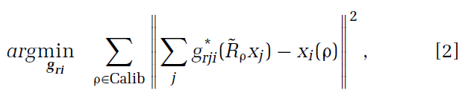
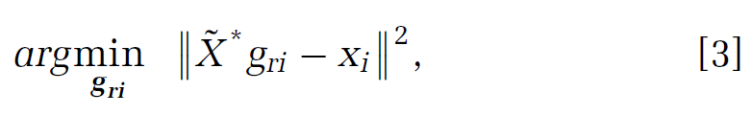

1.1 GRAPPA
Calibration is described by
$g_{ri} :concatenation of all{ g}_{rji}$
Matrix form,
$${\tilde{X}}^{∗}:matrix which has reordered \tilde{R_{r}}x_{i} vectors in the calibration area$$
The assumption is that if the calibration consistency holds within the calibration area, it also holds in other parts of k-space.

Slide 7



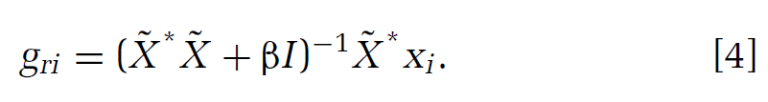
1.2 Tikhonov regularized least-square solution
Analytic solution of Tikhonov regularized least-squares

Slide 8
2.
Method
Solving inverse problem(reconstruction process) is governed by data consistency constraints
The consistency constraints are separated into
a) consistency with the calibration
b) consistency with the data acquisition

Slide 9
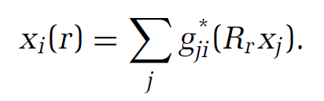
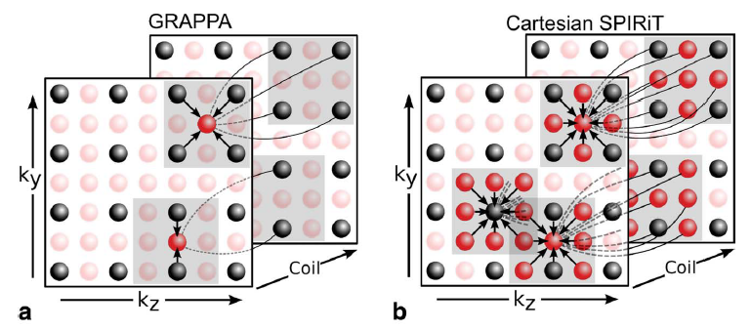

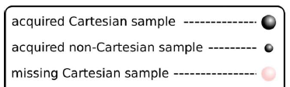

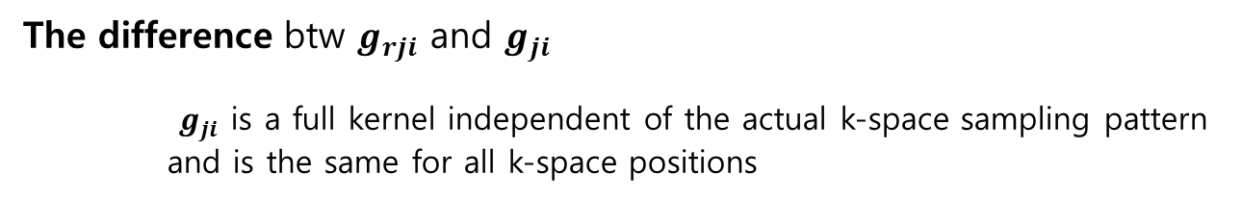
2.1 Consistency With the Calibration
GRAPPA : calibration consistency only between recovery points and the acquired points(${\tilde{R}}_{r}x_{i}$)
GRAPPA : focused on the number of data’s correlation
SPRiT : focused on data’s density correlation
SPIRiT : calibration consistency btw every point($R_{r}x_{i}$) and its entire neighborhood across all coils
The difference btw $g_{rji}$ and $g_{ji}$
$g_{ji}$ is a full kernel independent of the actual k-space sampling pattern
and is the same for all k-space positions

Slide 10


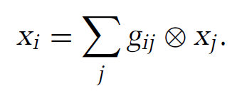

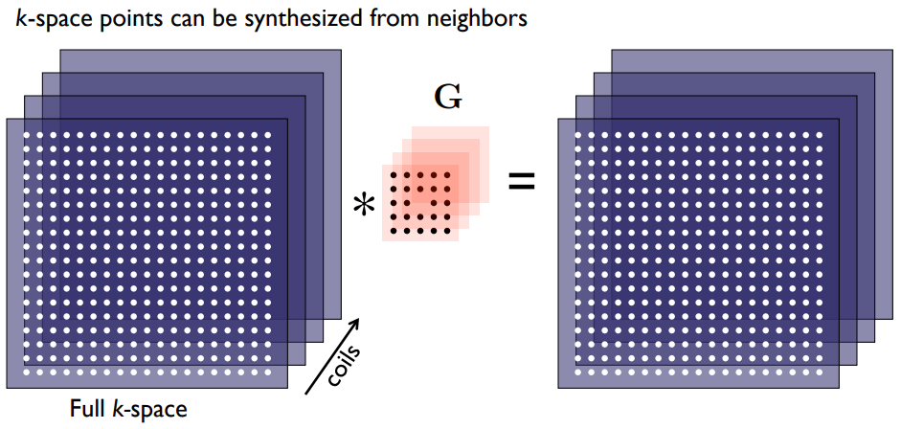

2.1 Consistency With the Calibration
The system of equations can simply be written as
x : the entire k$–$space grid data for all coils
$G :convolution operator$

Slide 11


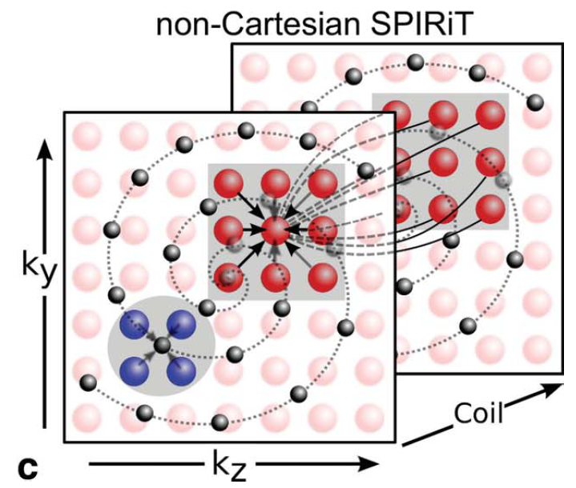
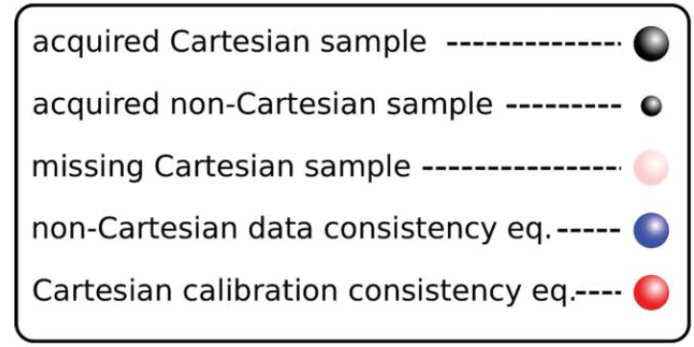
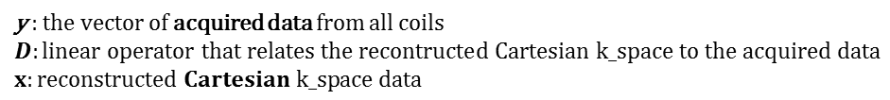
2.2 Consistency With the Data Acquisition
Matrix form of linear equations of data acquisition constraint
y : the vector of acquired data from all coils
$$D:linear operator that relates the recontructed Cartesian k_space to the acquired data$$
$x:reconstructed Cartesian k_space data$

Slide 12
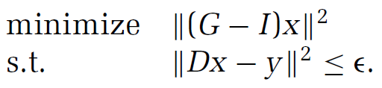

2.3 Constrained Optimization Formulation
Reconstruction optimization problem of [6] + [8]
Reformulation of [9] into unconstrained Lagrangian form
This equation can be solved by iterative method (steepest descent, conjugate gradient)

Slide 13

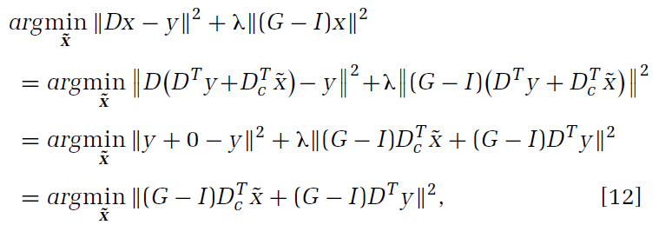

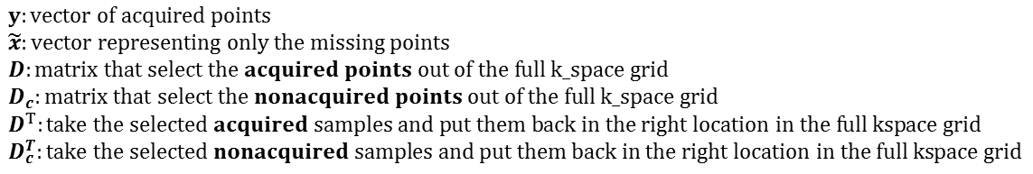
2.4 Arbitrary Cartesian Sampling
Leave the acquired k-space unchanged (ε → 0)
Start with a large λ and reduce it (more weight on calibration consistency)
$y:vector of acquired points$
$\tilde{x}:vector representing only the missing points$
$D:matrix that select the acquired points out of the full k_space grid$
$D_{c}:matrix that select the nonacquired points out of the full k_space grid$
$$D^{T}:take the selected acquired samples and put them back in the right location in the full kspace grid$$
$D_{c}^{T}:take the selected nonacquired samples and put them back in the right location in the full kspace grid$
Substituting into [10]

Slide 14
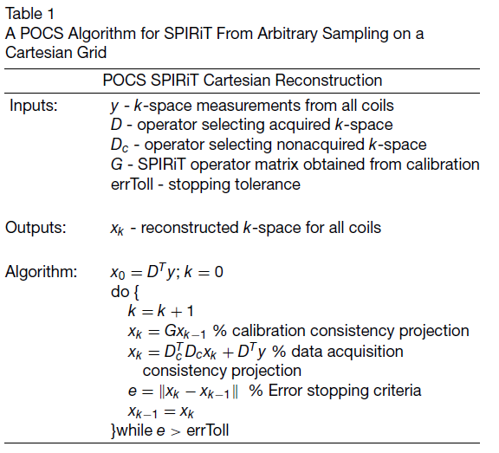
2.4.1 Projection Over Convex Sets(POCS) algorithm

Slide 15
2.5 Non-Cartesian Sampling
the practical success of the reconstruction depends on
how well the operators G and D approximate the true data and
how fast they can be computed in practice.
2.5.1 Calibration
The SPIRiT approach is autocalibrating.
We assume that there is always a subset of k-space that is sufficiently sampled for the purpose of calibration.

Slide 16
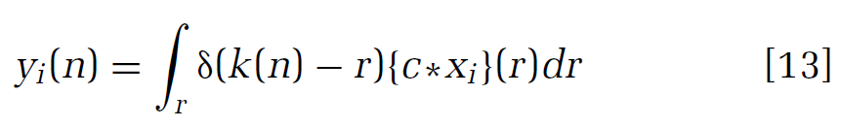
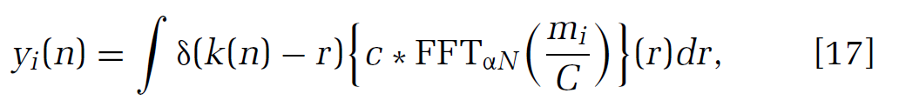
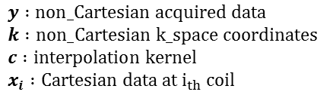
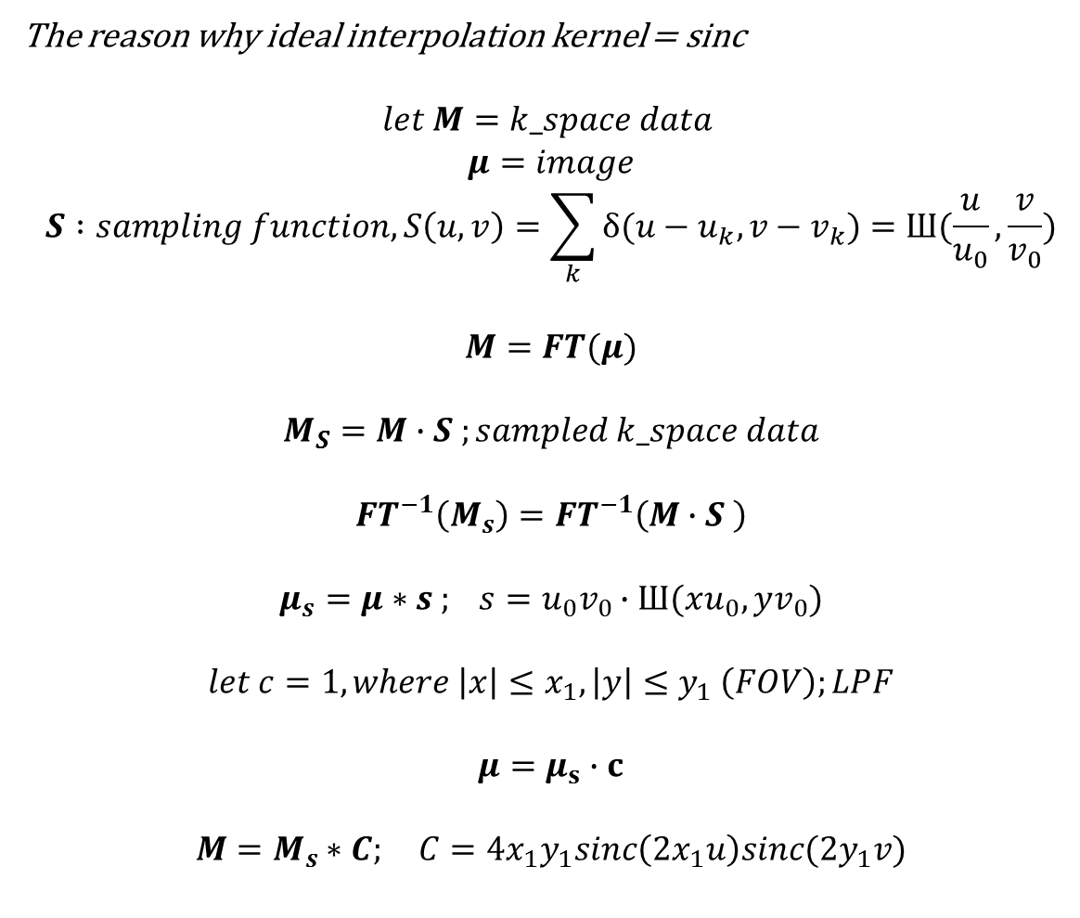
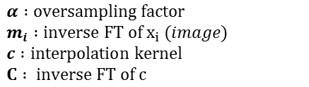
2.5.2 k-Space Domain Reconstruction
The reason why ideal interpolation kernel = sinc
$$let M=k_space data$$
$$μ=image$$
$$S :sampling function, S\left(u,v\right)=\sum_{k}{δ(u−u_{k},v−v_{k})}=Ш(\frac{u}{u_{0}},\frac{v}{v_{0}})$$
$$M=FT(μ)$$
$$M_{S}=M∙S ;sampled k_space data$$
$$FT^{−1}\left(M_{s}\right)=FT^{−1}\left(M∙S \right)$$
$$μ_{s}=μ∗s ; s=u_{0}v_{0}∙Ш(xu_{0},yv_{0})$$
$$let c=1, where \left|x\right|≤x_{1}, \left|y\right|≤y_{1} \left(FOV\right);LPF$$
$$μ=μ_{s}∙c$$
$$M=M_{s}∗C; C=4x_{1}y_{1}sinc\left(2x_{1}u\right)sinc(2y_{1}v)$$
Consider a convolution interpolation of data from a Cartesian grid to non-Cartesian grid
$y :non_Cartesian acquired data$
$k :non_Cartesian k_space coordinates$
$c :interpolation kernel$
$x_{i} :Cartesian data at i_{th} coil$
Image started interpolation equation
$α :oversampling factor$
$m_{i} :inverse FT of x_{i} (image)$
$c :interpolation kernel$
$C : inverse FT of c$
Ideally, the interpolation kernel, c, should be a sinc
However, a small size of kernel is used to reduce the computation
The errors associated with a small kernel are mitigated by oversampling the grid
And associated image weighting is mitigated by a deapodization

Slide 17





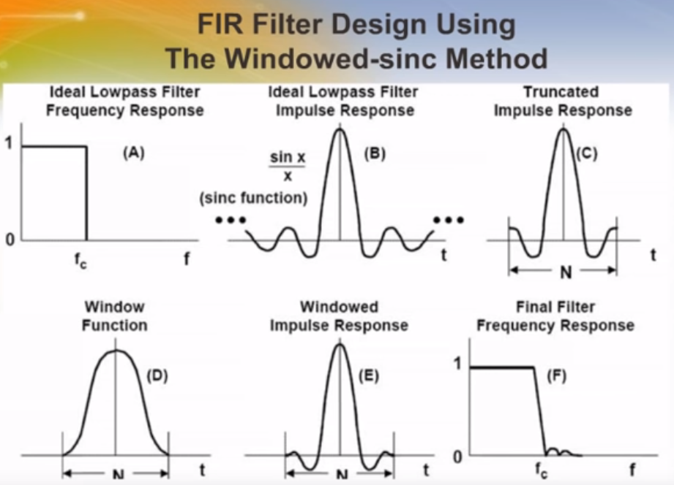
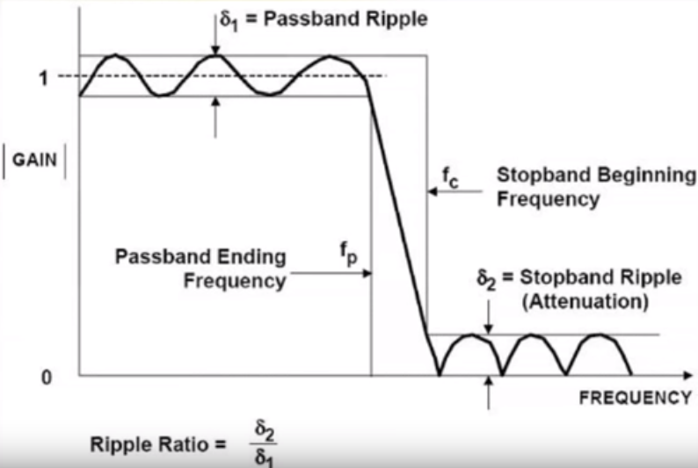

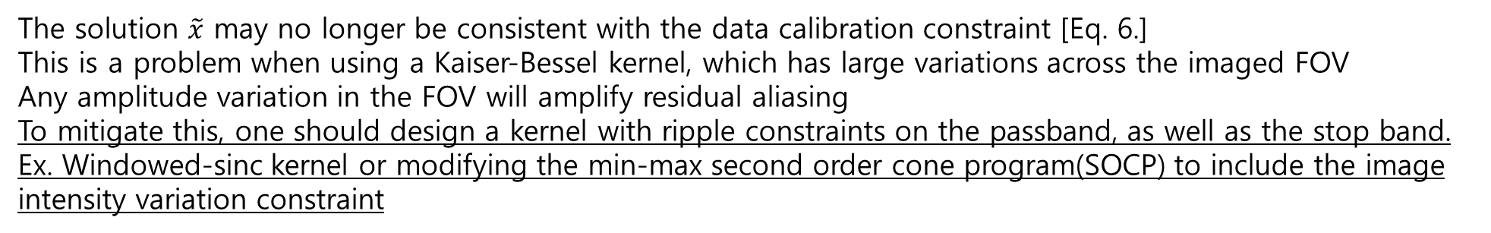

2.5.2 k-Space Domain Reconstruction
FIR filter(GRAPPA) vs IIR filter(SPIRiT)
The solution when using a non-sinc kernel,
$c :interpolation kernel, (c∗\tilde{c}$ = δ)
$c∗{\tilde{x}}_{i}=c∗\tilde{c}∗x_{i}≈x_{i}$
In the image domain,
$m_{i} :inverse FT of x_{i}$
$C : inverse FT of c$
The solution $\tilde{x}$ may no longer be consistent with the data calibration constraint [Eq. 6.]
This is a problem when using a Kaiser-Bessel kernel, which has large variations across the imaged FOV
Any amplitude variation in the FOV will amplify residual aliasing
To mitigate this, one should design a kernel with ripple constraints on the passband, as well as the stop band.
Ex. Windowed-sinc kernel or modifying the min-max second order cone program(SOCP) to include the image intensity variation constraint
= Imperfection from kernel affect data acquisition consistency (y=Dx) and sequentially affect calibration consistency ?
-> data acquisition consistency(y=Dx) using different kernel(gridding) from this
This kernel is for reconstruction

Slide 18
2.5.3 Revisiting the Calibration
The grid oversampling in k-space requires that the calibration kernel support be increased by the same amount.
Field of view of the oversampled grid or else the fidelity and integrity of the calibration may be compromised.
the interpolation kernel that grids the calibration region should have as little passband ripple as possible, again to ensure the fidelity of the calibration process.

Slide 19
3.
Reconstruction
• Design an appropriate interpolation kernel based on a
specific maximum aliasing amplitude, image weighting,
kernel width, and grid oversampling
• Perform a calibration that supports the oversampled
grid size to obtain the calibration weights
• Solve Eq. 10 using the CG algorithm to obtain reconstructed
Cartesian k-space data for all coils
• Reconstruct the images by computing the inverse Fourier transform
• Crop to the desired grid size
• Apodize the images by multiplying with the inverse
Fourier transform of the interpolation kernel.

Slide 20
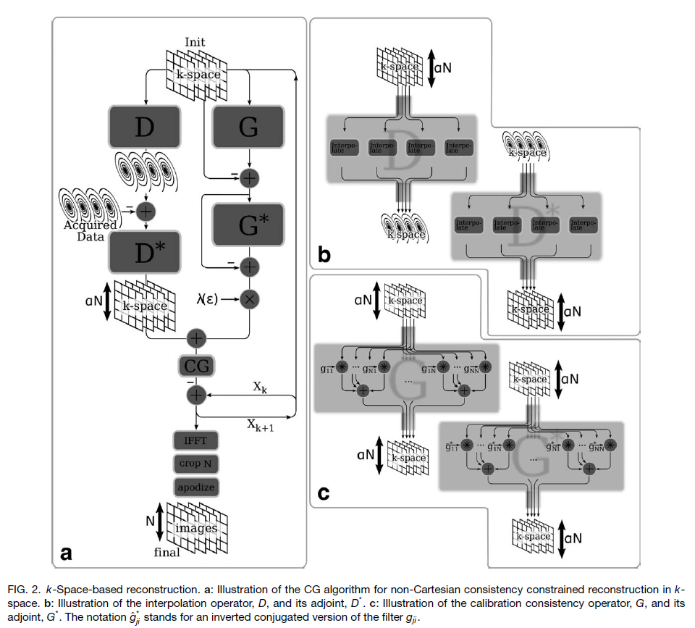
3.1 k-Space based reconstruction
: calculating the gradient of objective function(eq.11)
(x)
: acquisition data consistency term (interpolating error)
: calibration data consistency term
Fig. 2b : Illustration of convolution interpolation operator(D)
cartesian ↔ non-Cartesian, oversampling grid
Fig. 2c : Illustration of k-space convolution with
calibrated SPIRiT kernel operator(G)
cartesian, oversampling grid
(y)
Adv :
Does not requiring a FT during the iterations
Disadv :
To comply with the bandpass ripple requirement, the interpolation kernel is inevitably larger than what is commonly used for gridding (for the same interpolation error and grid oversampling).
A larger calibration kernel due to a oversampled grid increases the complexity of computation

Slide 21

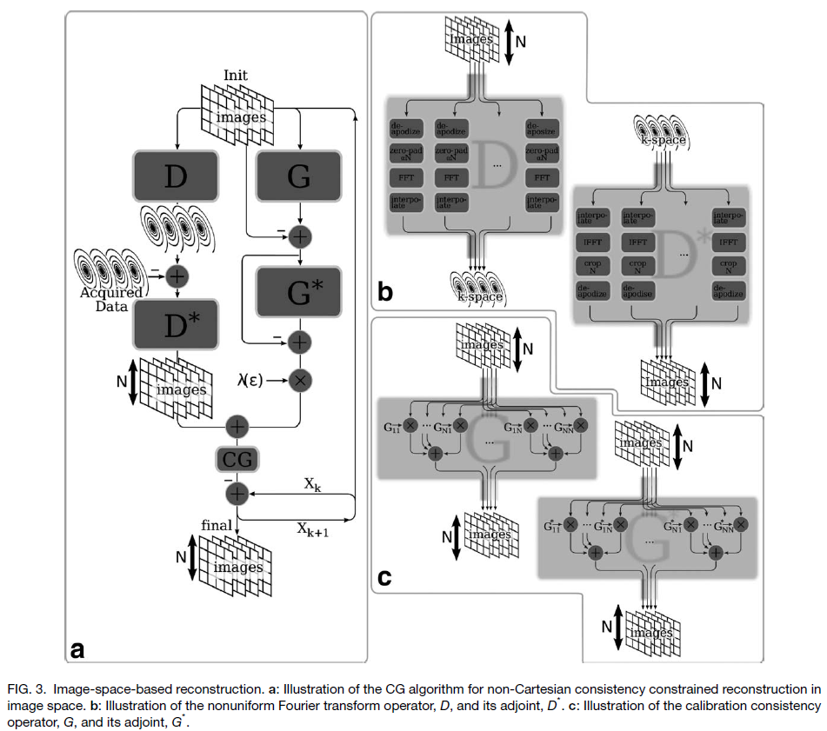




3.2 image-space based reconstruction
: calculating the gradient of objective function(eq.11)
(x)
: acquisition data consistency term (interpolating error)
: calibration data consistency term
Fig. 3b : Illustration of gridding operator(D)
nonuniform FT, [Eq. 17.]
Fig. 3c : Illustration of image multiplication operator (G)
(y)
Adv :
the convolution interpolation kernel can be very
small since it is possible to pre-compensate for the weighting in image space prior to taking the Fourier transform
large calibration kernels do not incur further increase in computational complexity since the convolution is implemented as a multiplication in image space.
Disadv :
Have to do FT in every single iteration step

Slide 22


3.3 Off-Resonance Correction
representing the reconstruction as a solution to a system of linear equations is that it is possible
to easily incorporate off-resonance variation in the reconstruction.
This is particularly important for non-Cartesian trajectories, where off-resonance frequencies lead to image blurring
The off-resonance correction appears in the data consistency constraint in Eq. 16 by modifying the nuFFT operator D to include off-resonance information.
modified nuFFT operator D [Eq. 17]
$Φ_{n}\left(r\right) :phase of the image$
Off-resonance : because of B_0 inhomogeneity
Acquired DC point might not be able to be exact-DC point
Space shift in k-space = phase shift in image domain (FT property)
=> By adding a phase information on image, correction a off-resonance effect

Slide 23
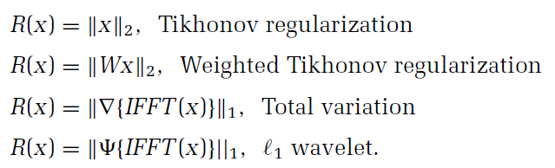
3.4 Regularization
The objective function can include additional terms in as well as constraints that express prior knowledge in the reconstruction.
R(x) is a penalty function that incorporates the prior knowledge and is very flexible because the penalty can be applied on the image, as well as k-space data.
Examples of potential penalties
L1 : rhombus shape => find the solution which has many 0’s => sparse
L2 : circle shape => find the solution which has minimum E

